Slide 1


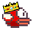
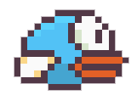

Luke Garrigan + Shane Sturgeon

Slide 2
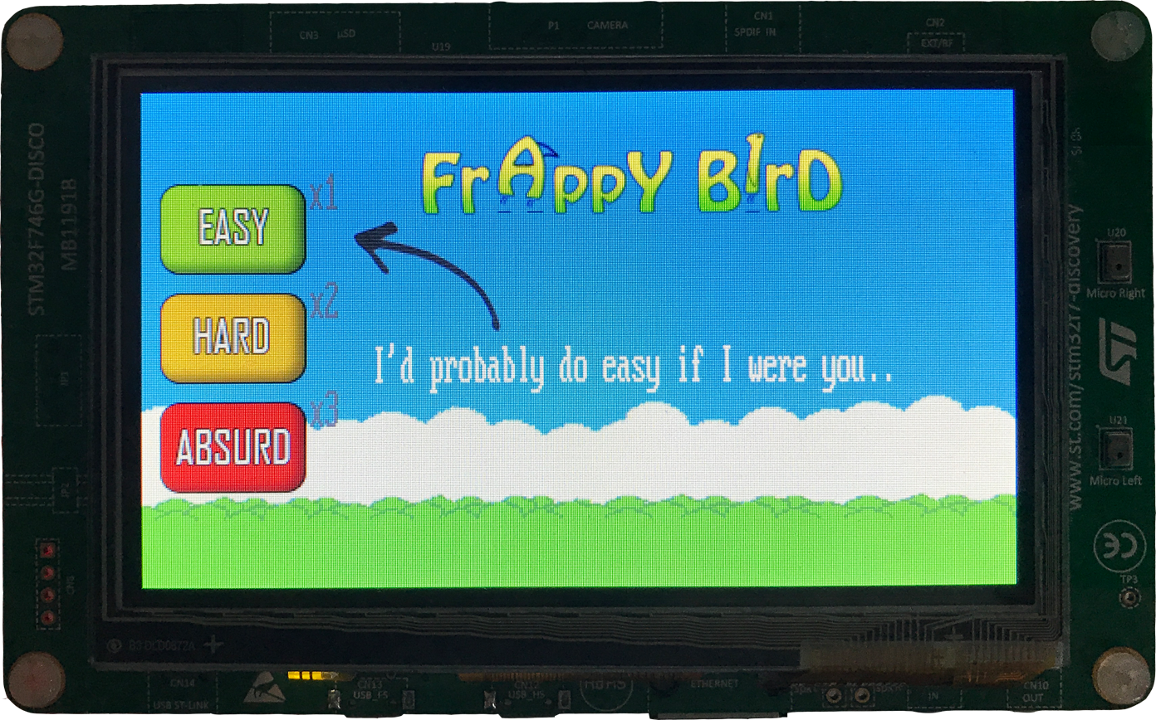
First Game Screen
Level experience multiplier

Slide 3

Every Bird Wants Coins!
+3 Points!

Slide 4
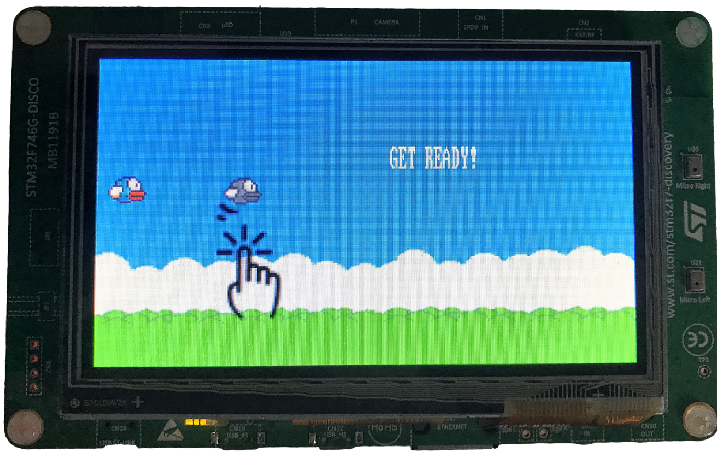
Pregame

Slide 5

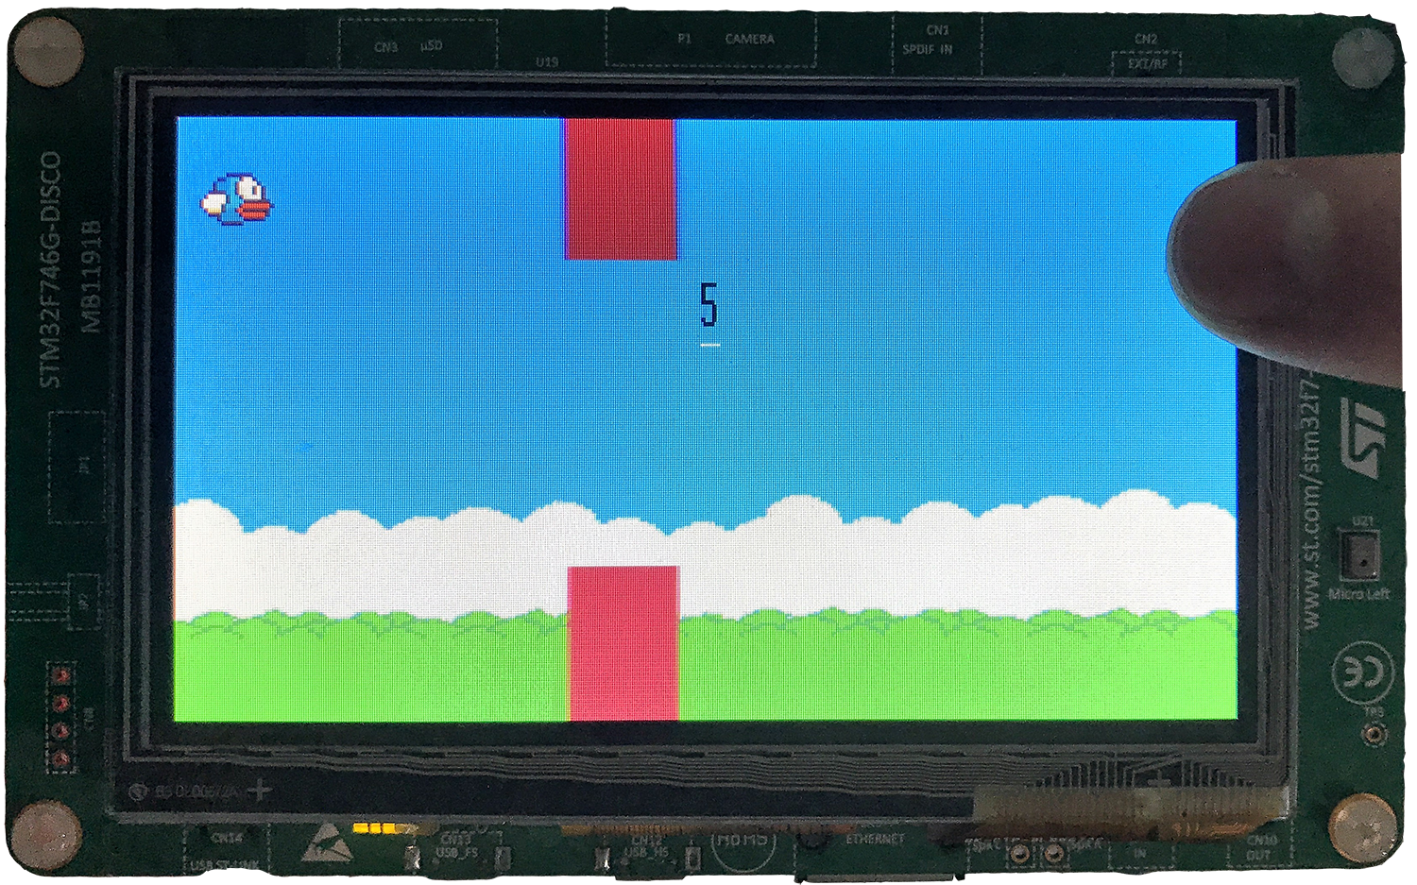
Difficulty:

Slide 6

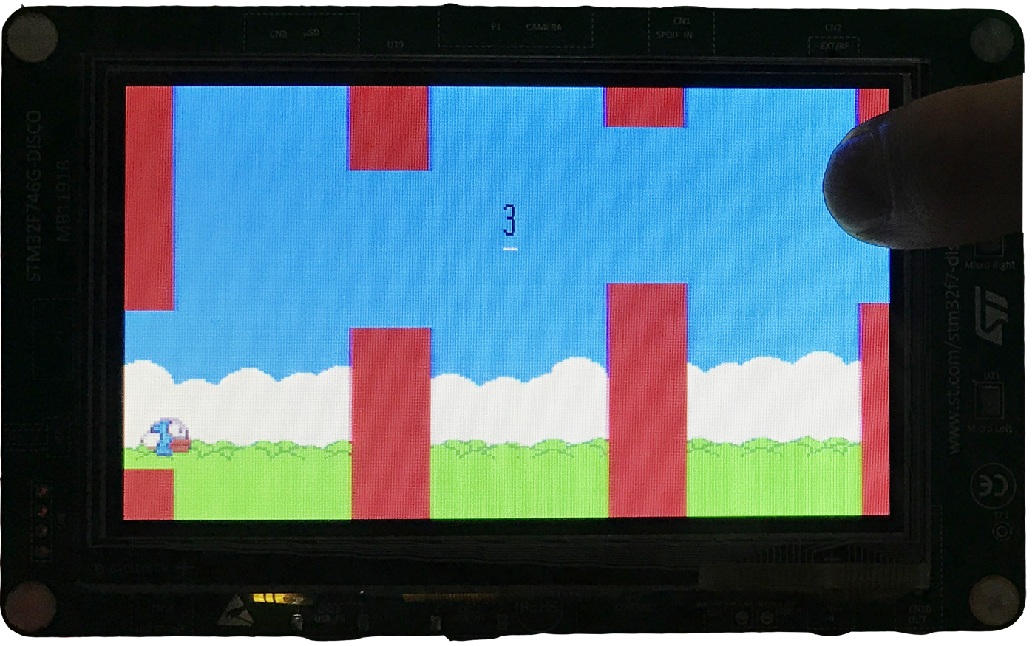
Difficulty:

Slide 7

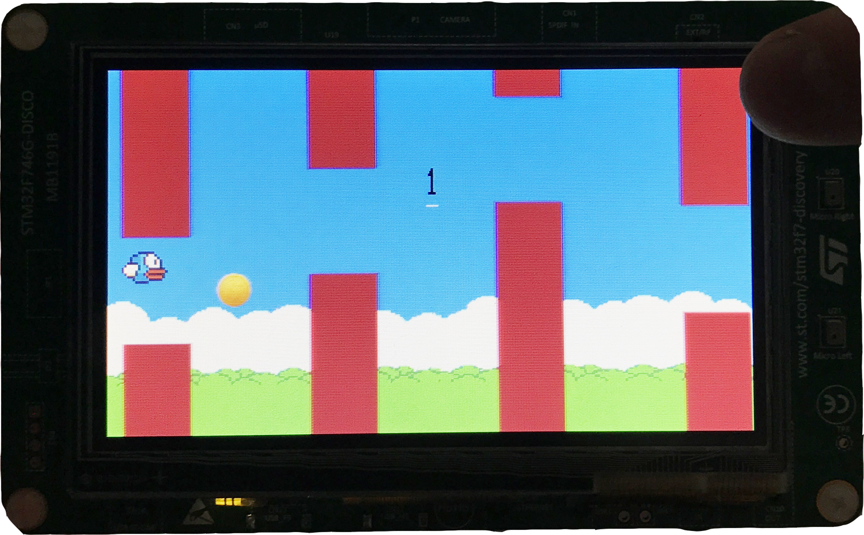
Difficulty:

Slide 8
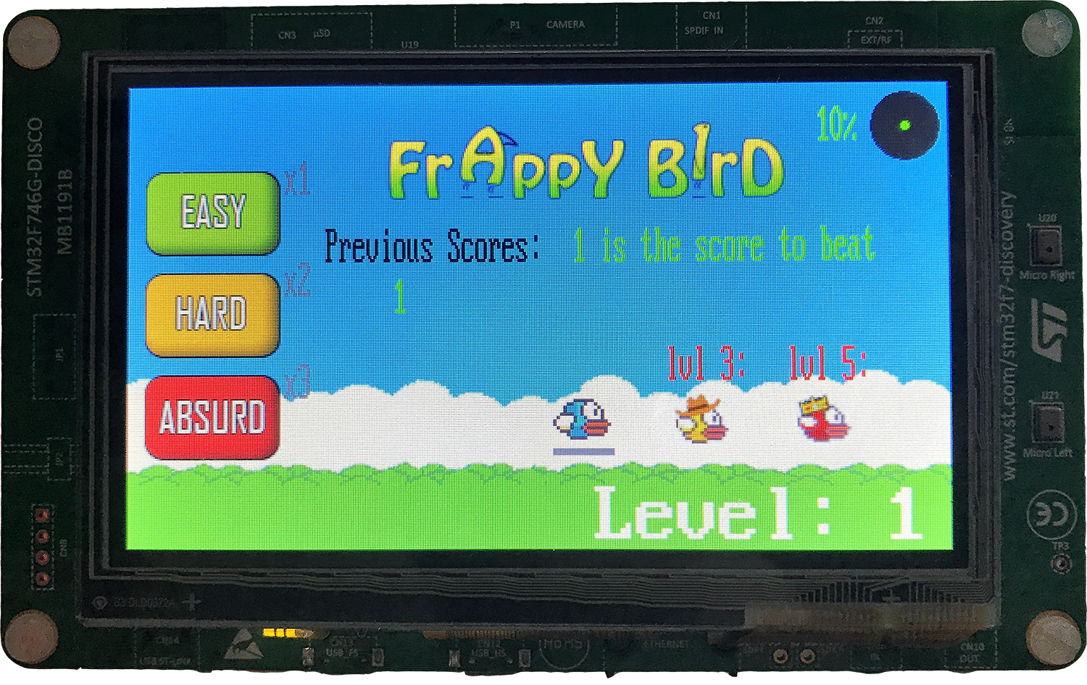
Displays last 4 achieved score
Main Menu
Level progress
Score to beat.
(This was Shane’s high score)
Unlockable
Birds!
Current level!

Slide 9
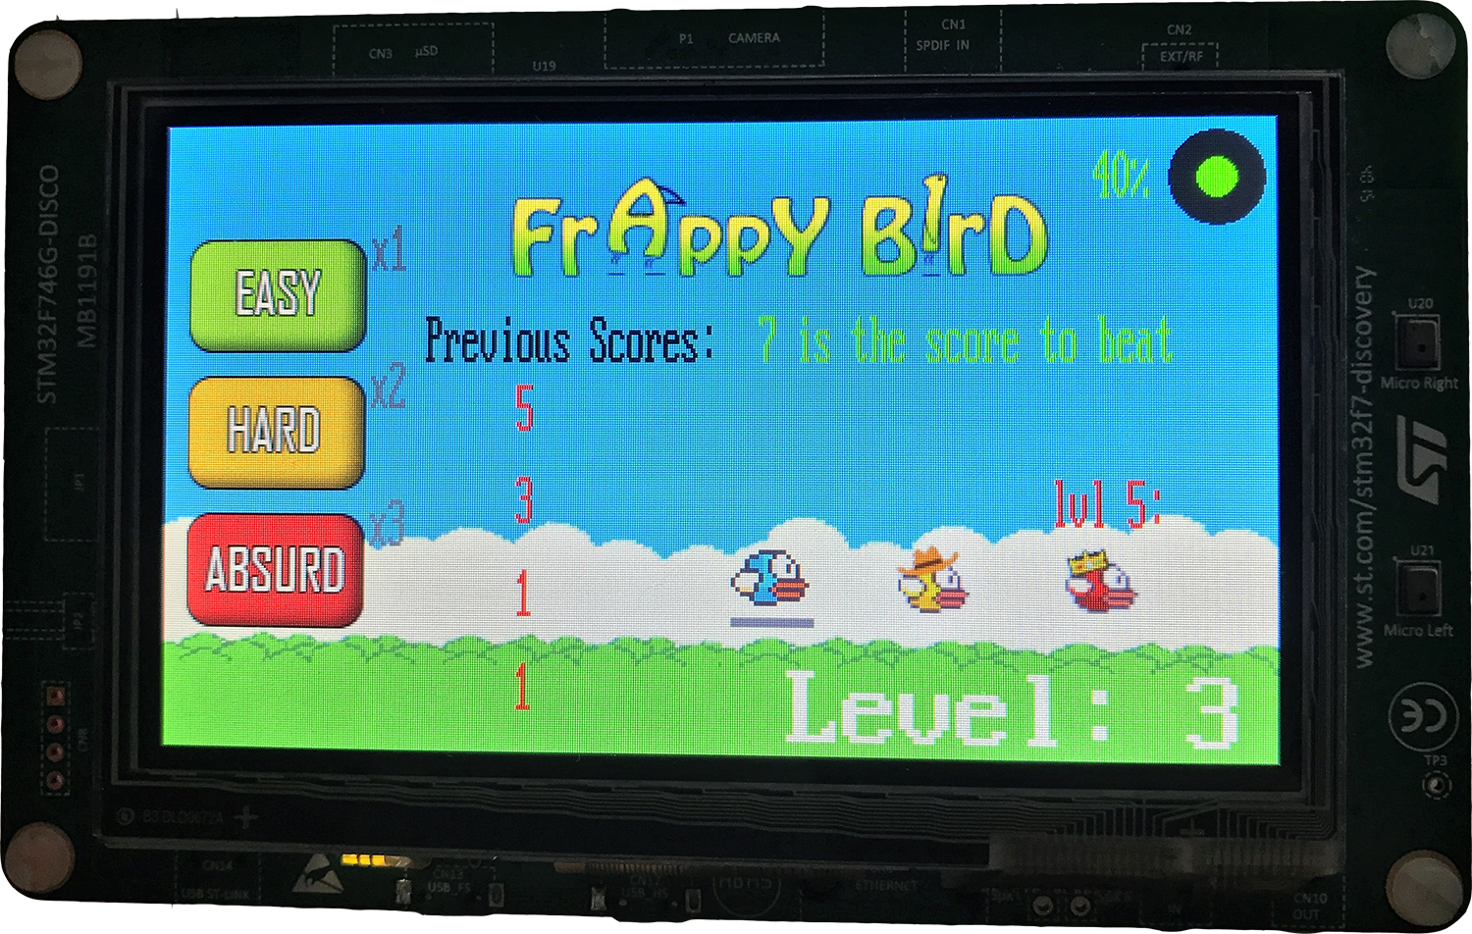
Unlocking Birds!
Bird is now unlocked!

Slide 10
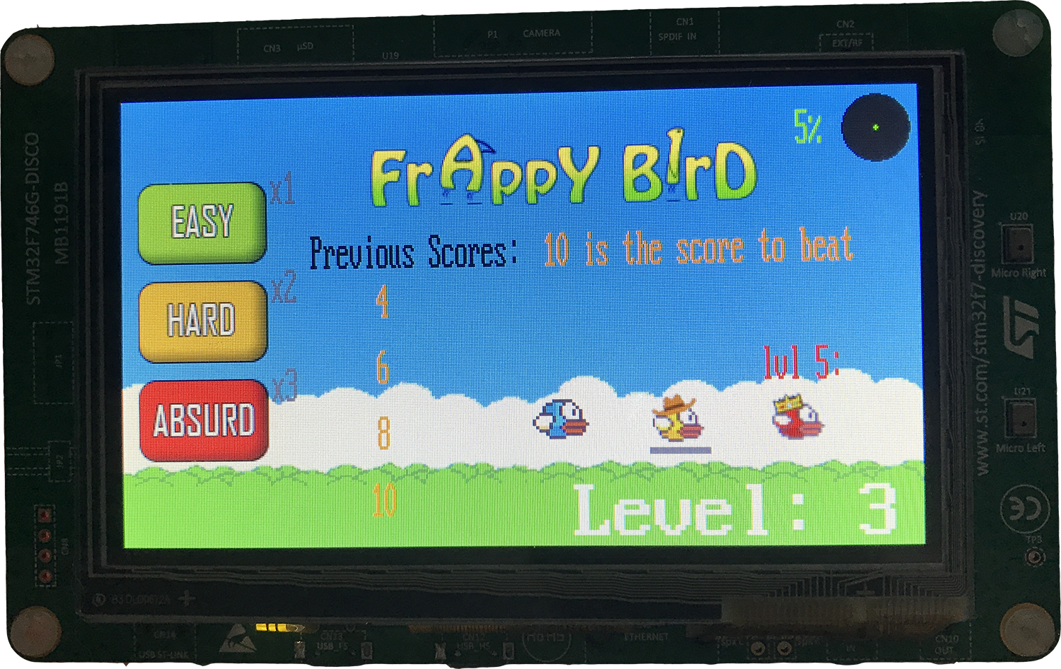
Choosing Birds!
Bird is now chosen!

Slide 11
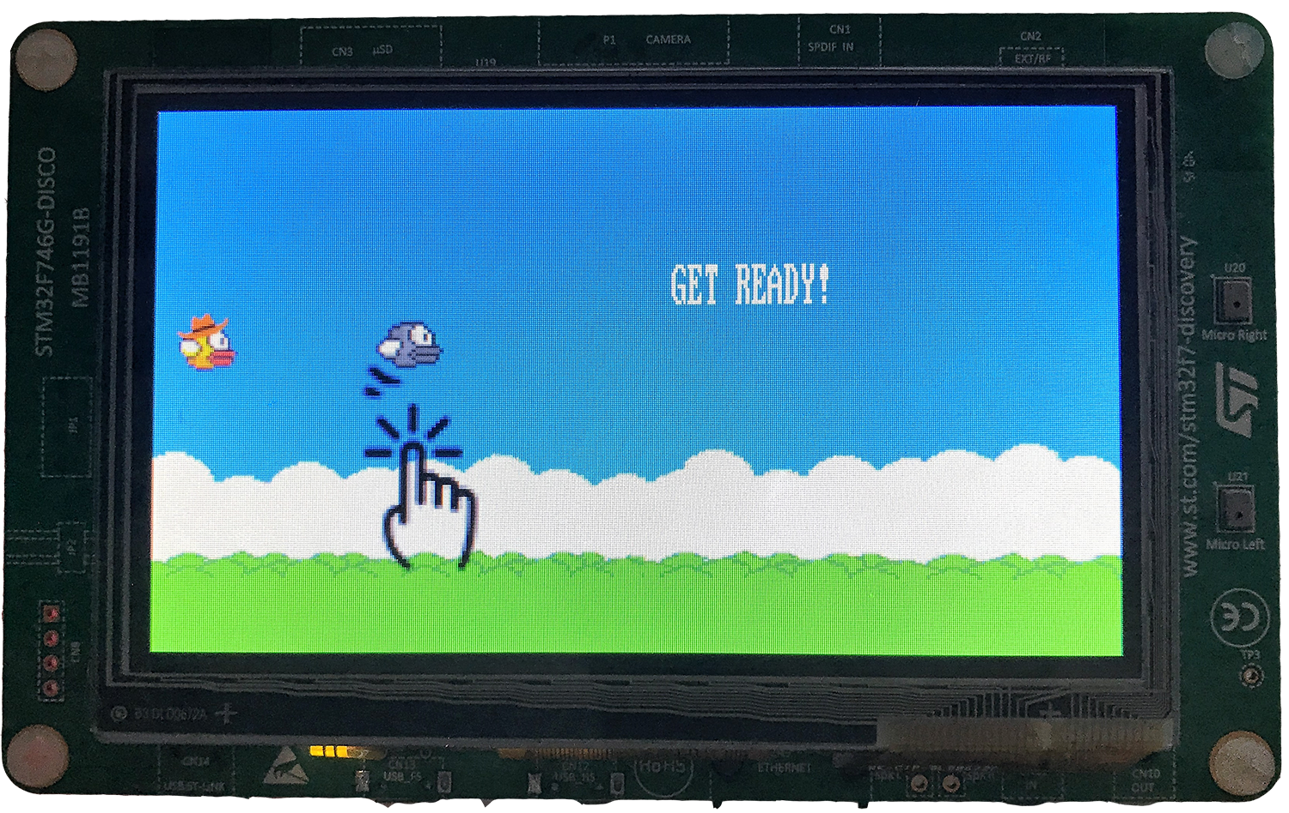
Try your new wings!

Slide 12
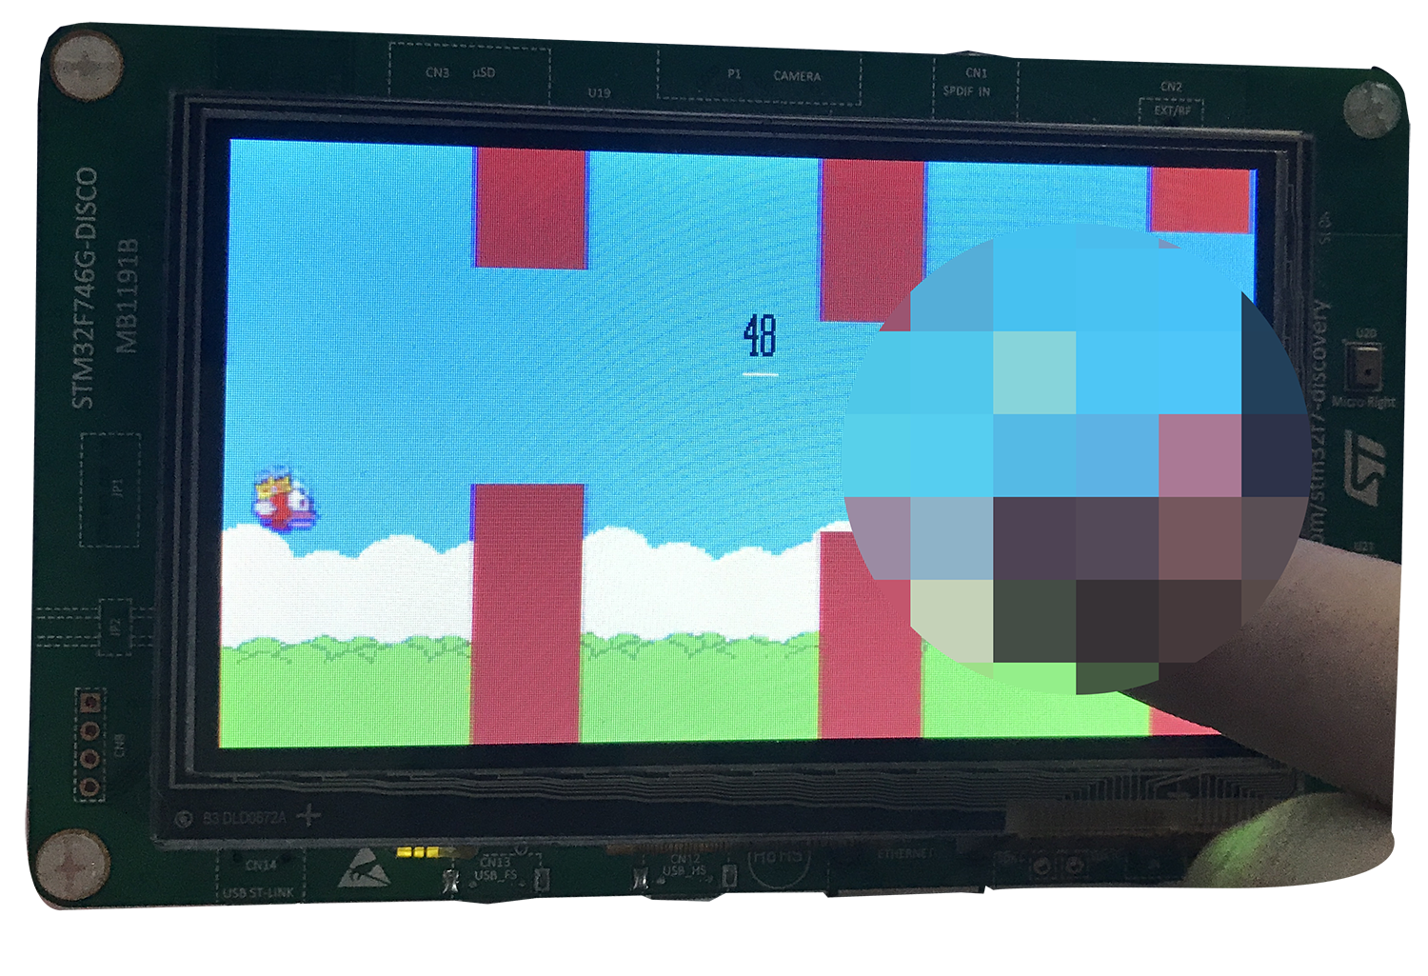
Easter Eggs!

